Slide 1

Financial Data Analysis
Presented By (Team 2)-
Abaneendra nayak
Nikita Karishma Kispotta
Harshal Gopal Badgujar
Lemkohli Sangtam
Sonal Soni
Mohammed Suhail Tc

Slide 2
Index
5 KPI’s Screenshot, Insights, Possible Solutions
Dashboard Screenshots, Conclusion
Challenges Faced
Learnings

Slide 3
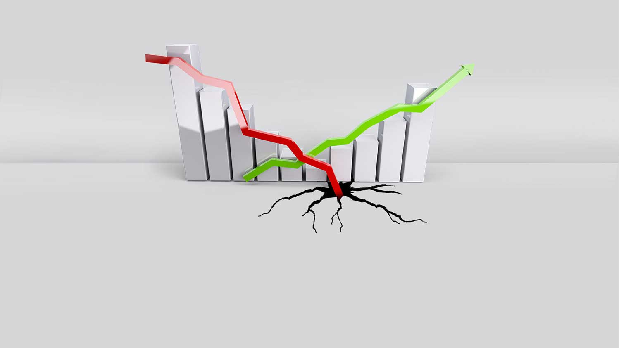
Business Objective
The dataset is about Bank Loan of Customers, we have to prepare the Dashboard and story for the total analysis.

Slide 4
Data Understanding and Cleaning
The data was first understood and then the data cleaning was done which was then used to do the analysis and get the result was shown by using different visualisation tools –
MS-Excel
My SQL
PowerBi
Tableau

Slide 5
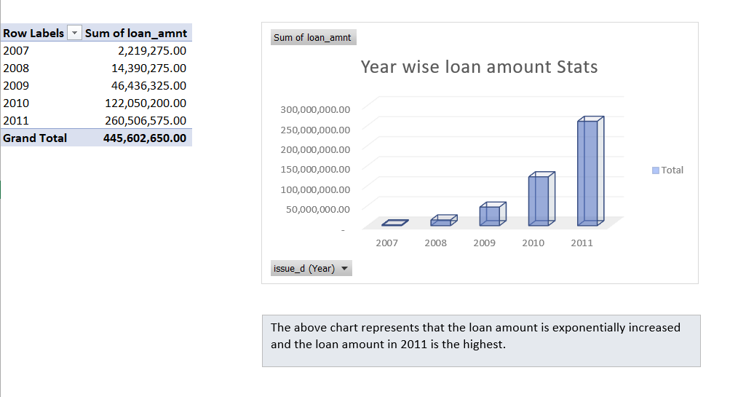
Year wise loan amount Stats

Slide 6
Insights:
High loan demand during 2007-2011 indicates economic growth and increased borrower confidence.
Lenient lending practices may have contributed to the significant loan amount increase.
Analyzing loan portfolio composition reveals potential concentration risks and diversification opportunities.
Monitoring loan quality is crucial to mitigate risks and ensure long-term stability.
Possible Solutions:
Strengthen lending standards and risk assessment processes.
Diversify loan portfolio across sectors/types for risk mitigation.
Enhance credit risk management through improved monitoring and early warning systems.
Utilize data analytics and modeling for better loan demand forecasting and risk assessment.

Slide 7
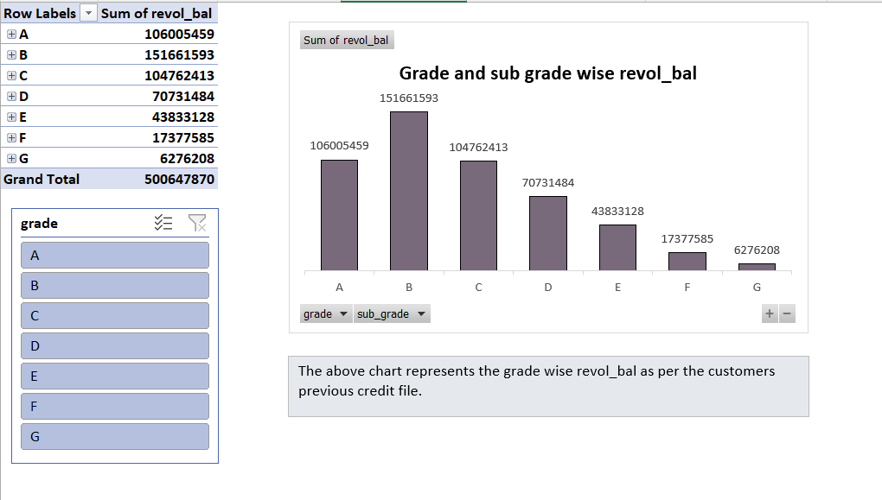
Grade and sub grade wise revol_bal

Slide 8
Insights:
Grade B loans: Highest revolving balance ($120M).
A grade loans: Second highest revolving balance ($115M).
C grade loans: Third highest revolving balance ($110M).
D grade loans: Lower revolving balance ($74M).
G grade loans: Lowest revolving balance.
Possible Solutions:
Implement targeted measures to decrease revolving balances in higher-grade loans.
Develop strategies to optimize revolving balances in A and C grade loans.
Implement risk management techniques to reduce revolving balances in D and G grade loans.
Encourage responsible credit utilization to minimize revolving balances across all loan grades.

Slide 9
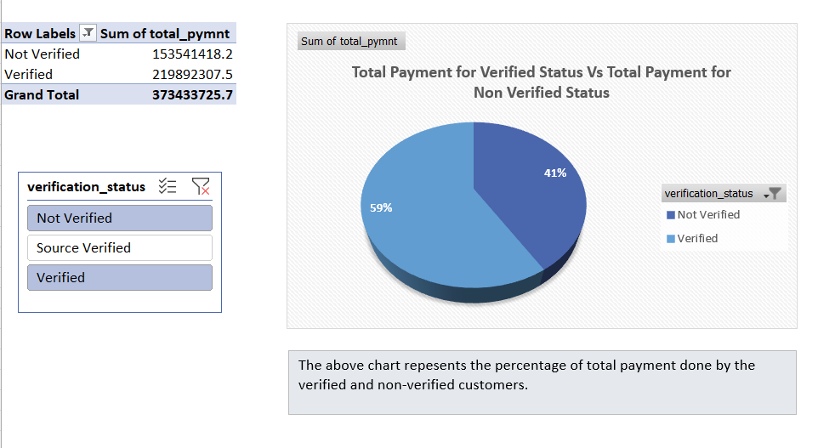
Total Payment for Verified Status Vs Total Payment for Non Verified Status

Slide 10
Insights:
Verified loans show the highest sum of total payments, indicating a higher level of repayment activity.
Not Verified loans closely follow, suggesting a similar level of payment engagement.
Source Verified loans, although slightly lower in total payment amounts, still demonstrate a considerable level of repayment.
Possible Solutions:
Strengthen the verification process for loans to ensure higher repayment activity.
Implement measures to encourage payment engagement and timely payments for Not Verified loans.
Enhance the verification process for Source Verified loans to further improve repayment levels.
Provide education and resources to borrowers to promote responsible payment behavior across all verification statuses.

Slide 11
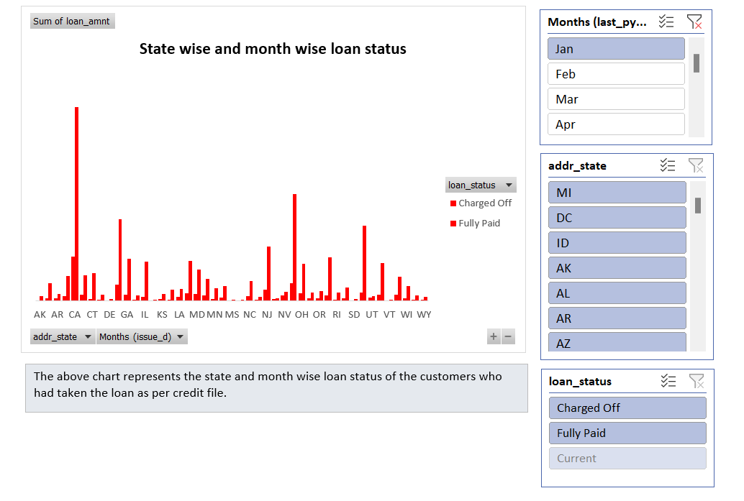
State wise and month wise loan status

Slide 12
Insights:
Fully paid status: Highest number of members (33k), indicating successful loan repayment.
Charged off status: 5k members, representing loans deemed uncollectible or in default.
Current status: 1.1k members, signifying active loans without delinquency issues.
Possible Solutions:
Learn from successful repayment patterns in fully paid loans for improved lending practices.
Strengthen credit assessment to minimize loans being charged off.
Provide personalized support to borrowers in current status for timely payments.
Enhance collection strategies to maximize recovery efforts for charged-off loans.

Slide 13
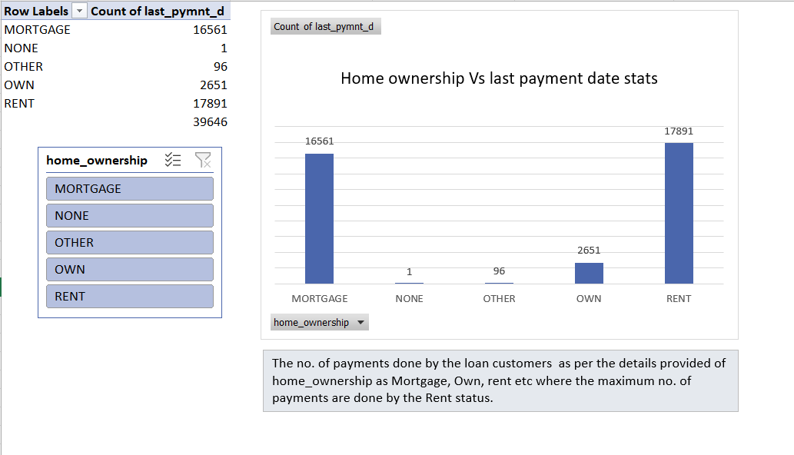
Home ownership Vs last payment date stats

Slide 14
Insights:
Majority (53%) of last payment amounts from individuals with a mortgage.
Renters contribute 39% of last payment amounts.
Homeowners with outright ownership represent 8% of last payment amounts.
"None" or "other" categories make up a negligible portion of last payments.
Possible Solutions:
Targeted mortgage products/services for timely payments and homeowner stability.
Promote affordable and accessible rental housing options for renters.
Support resources for managing financial responsibilities of homeowners with outright ownership.
Address challenges of individuals in "none" or "other" categories for increased homeownership and payment activity.

Slide 15
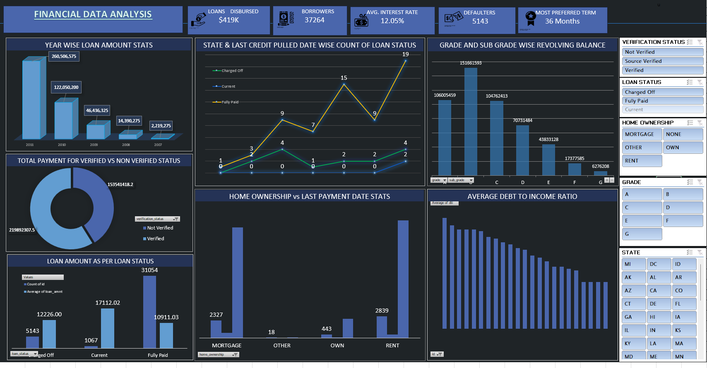
Excel Dashboard

Slide 16
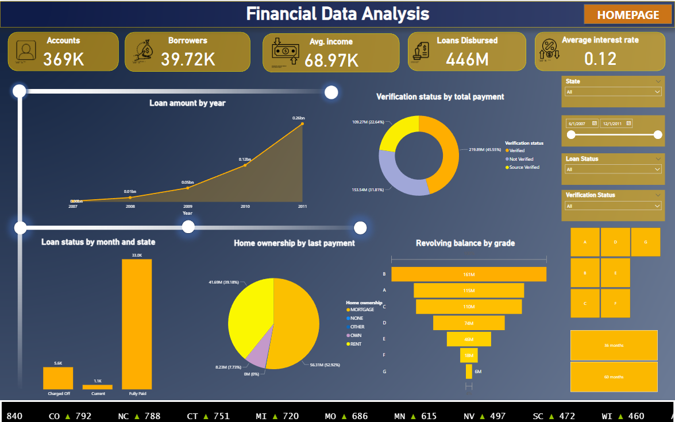
Power BI Dashboard
Contd..

Slide 17
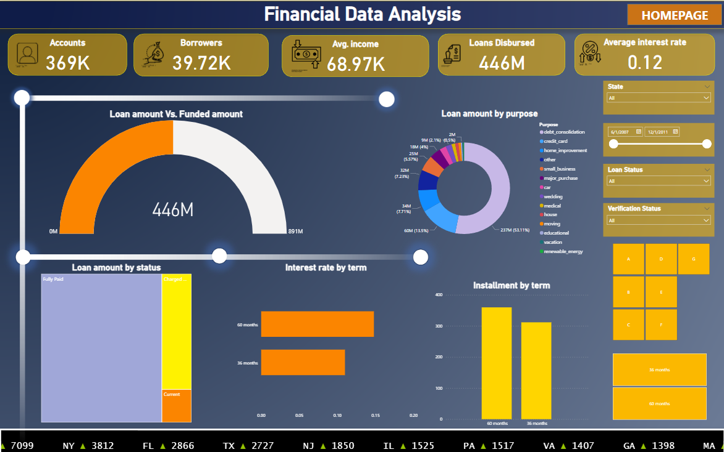

Slide 18
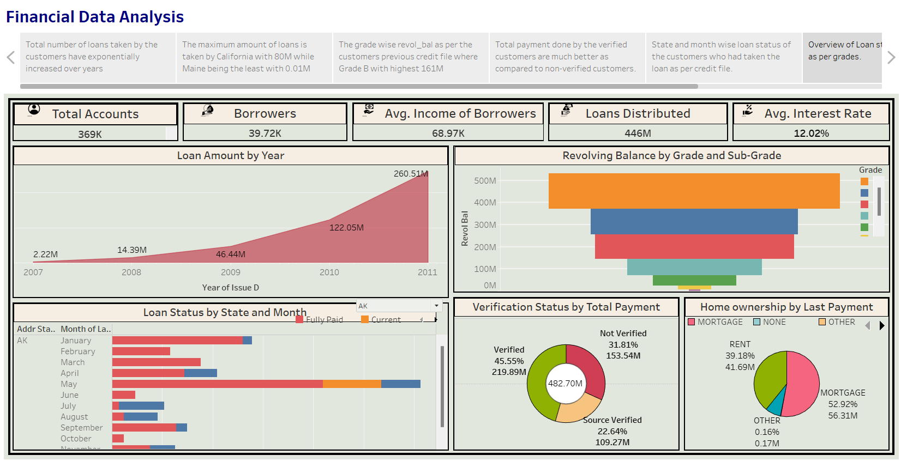
Tableau Story
Contd..

Slide 19
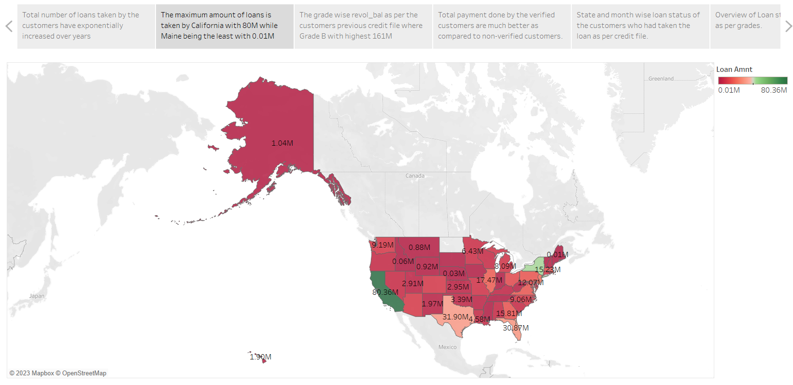
Contd..

Slide 20
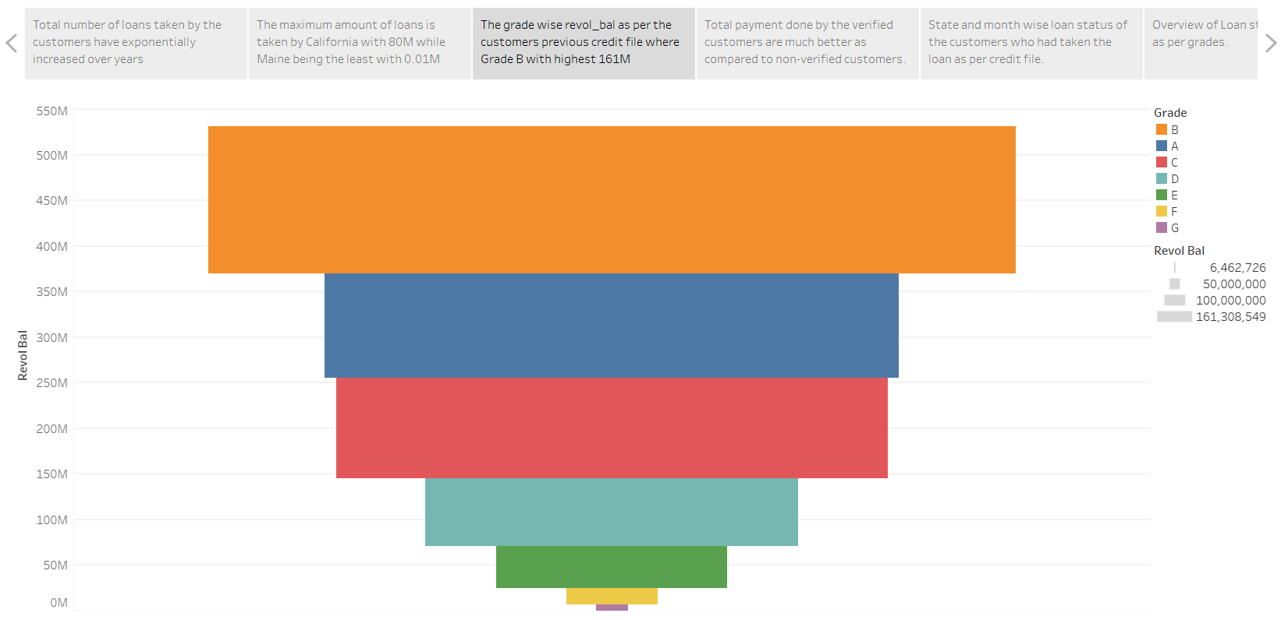
Contd..

Slide 21
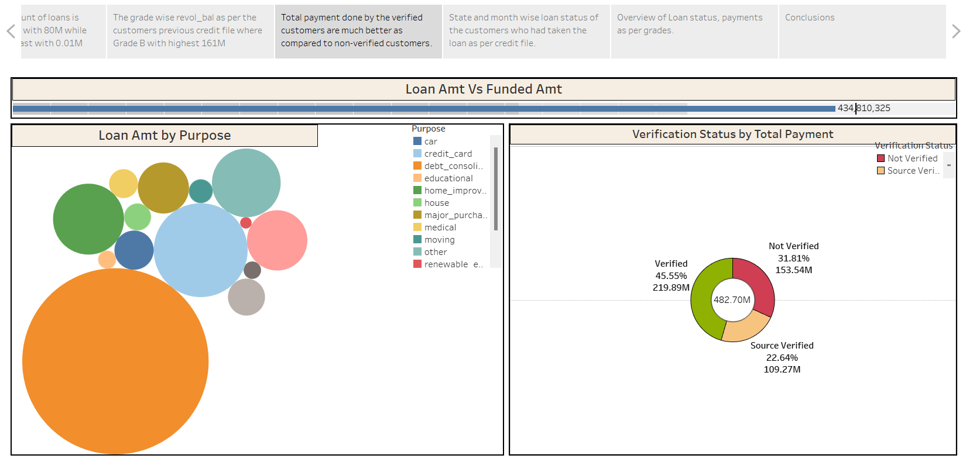
Contd..

Slide 22
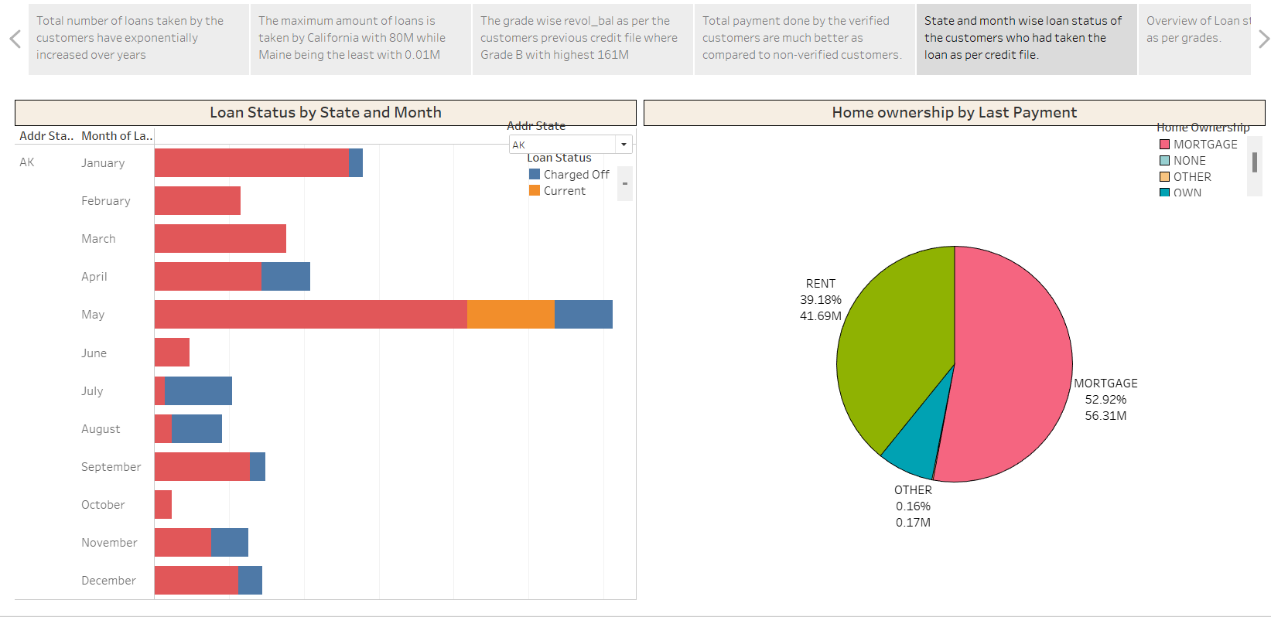
Contd..

Slide 23
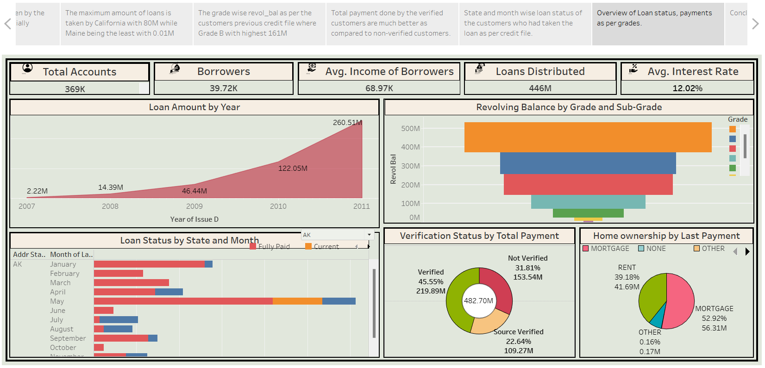
Contd..

Slide 24
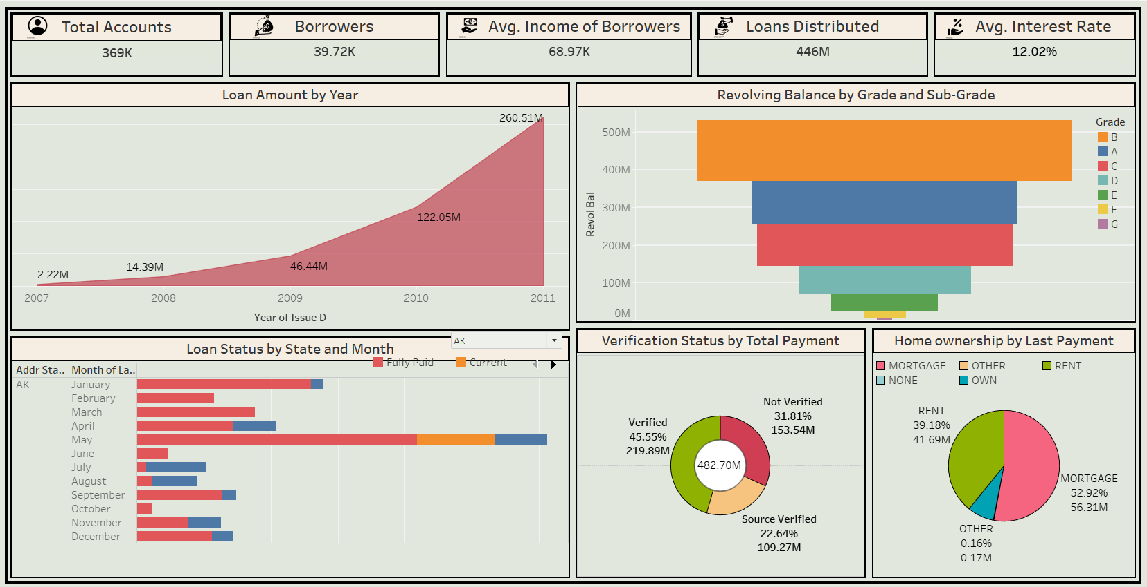
Tableau Story

Slide 25
Conclusions
In Kpi 1, the total loan amount experienced a staggering increase from 2007 to 2011, indicating a significant upward trend.
In Kpi 2, Grade B loans have the highest total revolving balance of 120 million, followed closely by A grade loans at 115 million. C grade loans rank third with a revolving balance of 110 million, while D grade loans have a lower balance of 74 million. The lowest revolving balance is observed in G grade loans.
In Kpi 3, verified loans demonstrate the highest sum of total payments, indicating a higher level of repayment activity. Not Verified loans closely follow, suggesting a similar level of payment engagement. Source Verified loans, although slightly lower in total payment amounts, still show a considerable level of repayment.
In Kpi 4, Fully Paid loans had the highest count of loan_status, reaching 32,950, indicating a significantly higher number compared to the lowest count of loan_status observed in Current loans at 1,140.
In Kpi 5, the majority, accounting for 53% of the sum of last_pymnt_amnt, belongs to individuals with a mortgage. Renters make up the second largest group, contributing 39% of the last payment amounts. Homeowners with outright ownership represent 8% of the last payment amounts. On the other hand, individuals categorized as "none" or "other" make up a negligible portion of the last payments
Highest no. of loan applicants has provided the home_ownership status as rent and are clearing the loan regularly when compared to others.
Best loan re-payments are done by the customers with good grade.
Financial firms are earning very high profit with every delinquency.

Slide 26
Challenges faced during data analysis:
Unfamiliarity with banking data abbreviations, requiring additional time for understanding and research.
Time-consuming process to comprehend the complex dataset.
Difficulty in merging files within Excel, hindering data consolidation.
Lack of year information in the issue_date field, necessitating data manipulation for accurate analysis.
Encountering errors while importing combined data into SQL for further analysis.
Needing to create views in SQL before successfully importing data into PowerBI.
Opting to import the file directly from MySQL to PowerBI due to technical limitations.
Discovering and utilizing advanced visualization settings in PowerBI to enhance insights and create impactful visual representations.

Slide 27
Lessons from analyzing bank financial data: overcoming challenges
Learn and understand the abbreviations used in banking data to avoid confusion during analysis.
Take time to study and grasp the complexity of the dataset for accurate insights.
Improve Excel skills to easily combine and merge multiple files.
Ensure data has complete and consistent information, including proper date formats.
Troubleshoot and fix import errors when using SQL for data analysis.
Utilize SQL views to simplify data importing into visualization tools like PowerBI.
Import data directly from the database if there are compatibility issues between MySQL and PowerBI.
Explore and experiment with visualization settings in PowerBI to create impactful and easy-to-understand visual representation.

Slide 28
THANK YOU

